Slide 1
Acts 9:1-19
Meanwhile, Saul was still breathing out murderous threats against the Lord's disciples. He went to the high priest 2 and asked him for letters to the synagogues in Damascus, so that if he found any there who belonged to the Way, whether men or women, he might take them as prisoners to Jerusalem. 3 As he neared Damascus on his journey, suddenly a light from heaven flashed around him. 4 He fell to the ground and heard a voice say to him, "Saul, Saul, why do you persecute me?" 5 "Who are you, Lord?" Saul asked.

Slide 2
Acts 9:1-19
6 "I am Jesus, whom you are persecuting," he replied. "Now get up and go into the city, and you will be told what you must do." 7 The men traveling with Saul stood there speechless; they heard the sound but did not see anyone. 8 Saul got up from the ground, but when he opened his eyes he could see nothing. So they led him by the hand into Damascus. 9 For three days he was blind, and did not eat or drink anything. 10In Damascus there was a disciple named Ananias. The Lord called to him in a vision, "Ananias!" "Yes, Lord," he answered.

Slide 3
Acts 9:1-19
11The Lord told him, "Go to the house of Judas on Straight Street and ask for a man from Tarsus named Saul, for he is praying. 12In a vision he has seen a man named Ananias come and place his hands on him to restore his sight." 13"Lord," Ananias answered, "I have heard many reports about this man and all the harm he has done to your saints in Jerusalem. 14And he has come here with authority from the chief priests to arrest all who call on your name."

Slide 4
Acts 9:1-19
15But the Lord said to Ananias, "Go! This man is my chosen instrument to carry my name before the Gentiles and their kings and before the people of Israel. 16I will show him how much he must suffer for my name." 17Then Ananias went to the house and entered it. Placing his hands on Saul, he said, "Brother Saul, the Lord--Jesus, who appeared to you on the road as you were coming here--has sent me so that you may see again and be filled with the Holy Spirit." 18Immediately, something like scales fell from Saul's eyes, and he could see again. He got up and was baptized, 19and after taking some food, he regained his strength.

Slide 5
Life in the Early Church
Challenges and Consequences
9 Jan - Kay Brown – Intro to Acts
16 Jan - Woody Baker – Peter & John
23 Jan - Ian Graham – Stephen
30 Jan - Sue de Pyle – Saul/Paul

Slide 6
Life in the Early Church
Challenges and Consequences
Sue de Pyle – Saul/Paul

Slide 7
What’s in a name?
Abram - Abraham, Sarai - Sarah
Saul - Hebrew name
Paul - Roman name

Slide 8
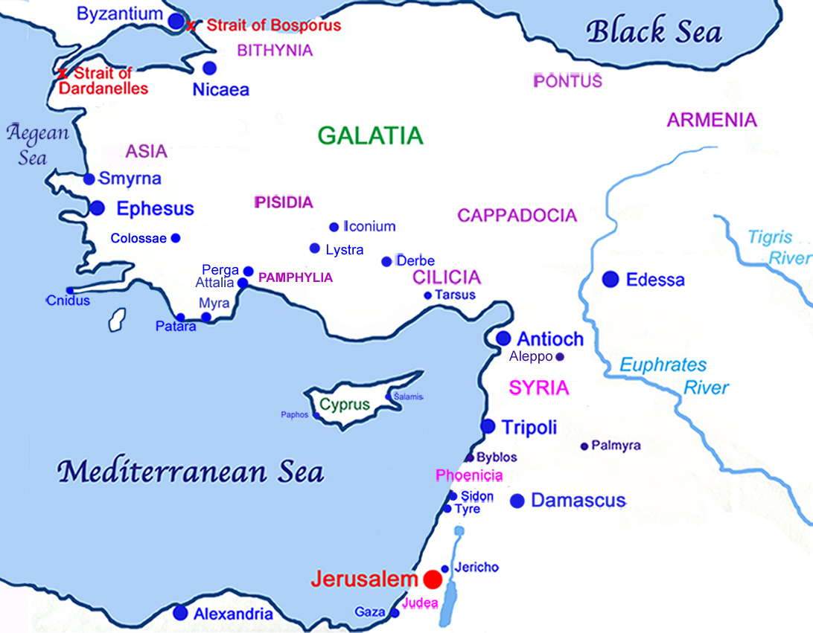
Who is this man Saul?
Born in Tarsus (Roman citizenship)
From a Jewish family
Studied under Gamaliel
Pharisee, studied Hebrew Scriptures
Present at stoning of Stephen

Slide 9
Acts 8:1-3
And Saul was there, giving approval to his death. On that day a great persecution broke out against the church at Jerusalem, and all except the apostles were scattered throughout Judea and Samaria. Godly men buried Stephen and mourned deeply for him. But Saul began to destroy the church. Going from house to house, he dragged off men and women and put them in prison.

Slide 10
Acts 9:1-2
Meanwhile, Saul was still breathing out murderous threats against the Lord’s disciples. He went to the high priest and asked him for letters to the synagogues in Damascus, so that if he found any there who belonged to the Way, whether men or women, he might take them as prisoners to Jerusalem.

Slide 11
Who is this man Saul?
Born in Tarsus (Roman citizenship)
From a Jewish family
Studied under Gamaliel
Pharisee, studied Hebrew Scriptures
Present at stoning of Stephen
Went from house to house in Jerusalem to arrest Christians
Wanted to do the same in Damascus

Slide 12
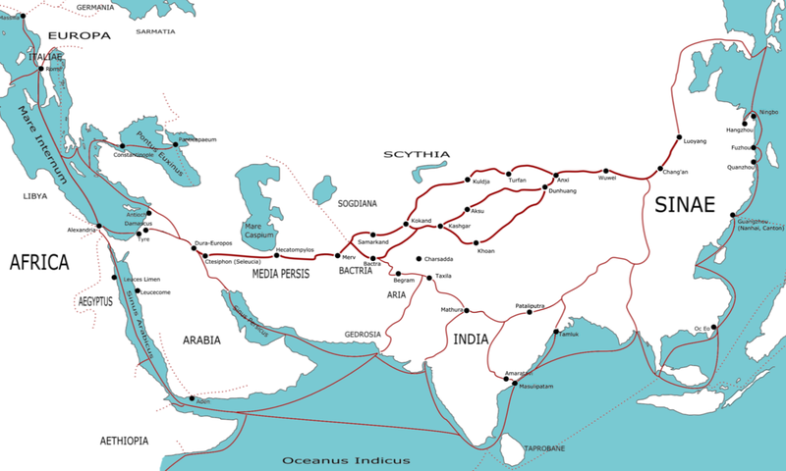
Why Damascus?
Major city near to Jerusalem
Large Jewish population
Commercial hub in the region
Any ideology that took hold here would spread far and wide quite easily.

Slide 13
Acts 9:3-9
As he neared Damascus on his journey, suddenly a light from heaven flashed around him. He fell to the ground and heard a voice say to him, “Saul, Saul, why do you persecute me?”
“Who are you, Lord?” Saul asked.
“I am Jesus, whom you are persecuting,” he replied. “Now get up and go into the city, and you will be told what you must do.”
The men travelling with Saul stood there speechless; they heard the sound but did not see anyone. Saul got up from the ground, but when he opened his eyes he could see nothing. So they led him by the hand into Damascus. For three days he was blind, and did not eat or drink anything.

Slide 14
Acts 9:10-12
In Damascus there was a disciple named Ananias. The Lord called to him in a vision, “Ananias!”
“Yes, Lord,” he answered.
The Lord told him, “Go to the house of Judas on Straight Street and ask for a man from Tarsus named Saul, for he is praying. In a vision he has seen a man named Ananias come and place his hands on him to restore his sight.”

Slide 15
Acts 9:12-16
“Lord,” Ananias answered, “I have heard many reports about this man and all the harm he has done to your holy people in Jerusalem. And he has come here with authority from the chief priests to arrest all who call on your name.”
But the Lord said to Ananias, “Go! This man is my chosen instrument to carry my name before the Gentiles and their kings and before the people of Israel. I will show him how much he must suffer for my name.”

Slide 16
Acts 9:17-19
Then Ananias went to the house and entered it. Placing his hands on Saul, he said, “Brother Saul, the Lord - Jesus, who appeared to you on the road as you were coming here - has sent me so that you may see again and be filled with the Holy Spirit.” Immediately, something like scales fell from Saul’s eyes, and he could see again. He got up and was baptized, and after taking some food, he regained his strength.

Slide 17
Challenges and Consequences
Saul was a significant challenge to the early church
He suffered the consequence of people not trusting his transformation was legitimate.
Would have been easy for Saul to be consumed by guilt
Saul understood the transforming power of the Holy Spirit.
2 Corinthians 5:17 “Therefore if anyone is in Christ, he is a new creation; the old has gone, the new has come.”
Ministry to Gentiles - Roman name

Slide 18
How good is good enough?
Romans 3:21-25
But now apart from the law the righteousness of God has been made known, to which the Law and the Prophets testify. This righteousness is given through faith in Jesus Christ to all who believe. There is no difference between Jew and Gentile, for all have sinned and fall short of the glory of God, and all are justified freely by his grace through the redemption that came by Christ Jesus. God presented Christ as a sacrifice of atonement, through the shedding of his blood - to be be received by faith.

